Slide 1
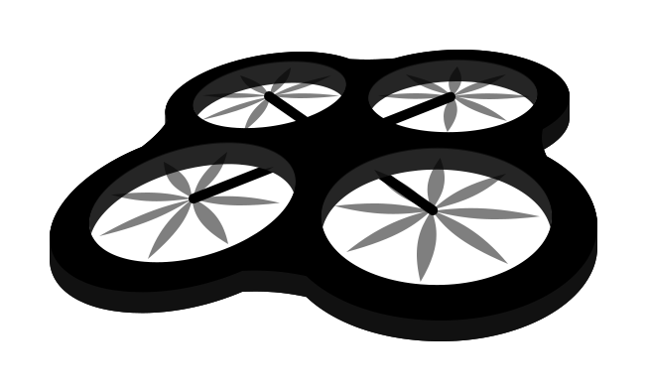


The Drone Delivery Cycle
Drone
Sends Drone with correct taco
Delivers Taco to User
Automated Operator
User
Orders a Taco

Slide 2

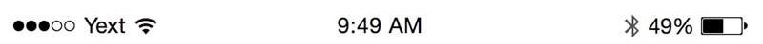
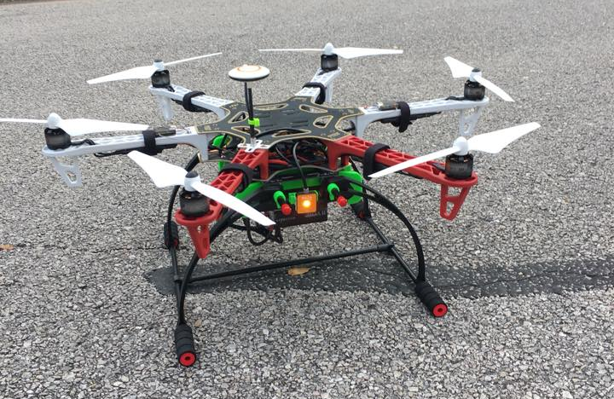

Databases:
User
User actions:
Log in
View TAC
TACO
DRONE
Join TacoDrone the first taco drone delivery service at SXSW…
Terms and Conditions

Slide 3
Databases:
?
User Actions:
Go back
TACO
DRONE
Terms and Conditions
Supply of Services
Whilst we will use our reasonable endeavours to supply the services, we shall not be responsible for any failure to provide services or any unavailability. We make no warranty against a failure to deliver a taco, a defect or problems which may occur. We will not be responsible for any loss or damage whatsoever caused resulting from a failure to provide you a taco.
Back

Slide 4
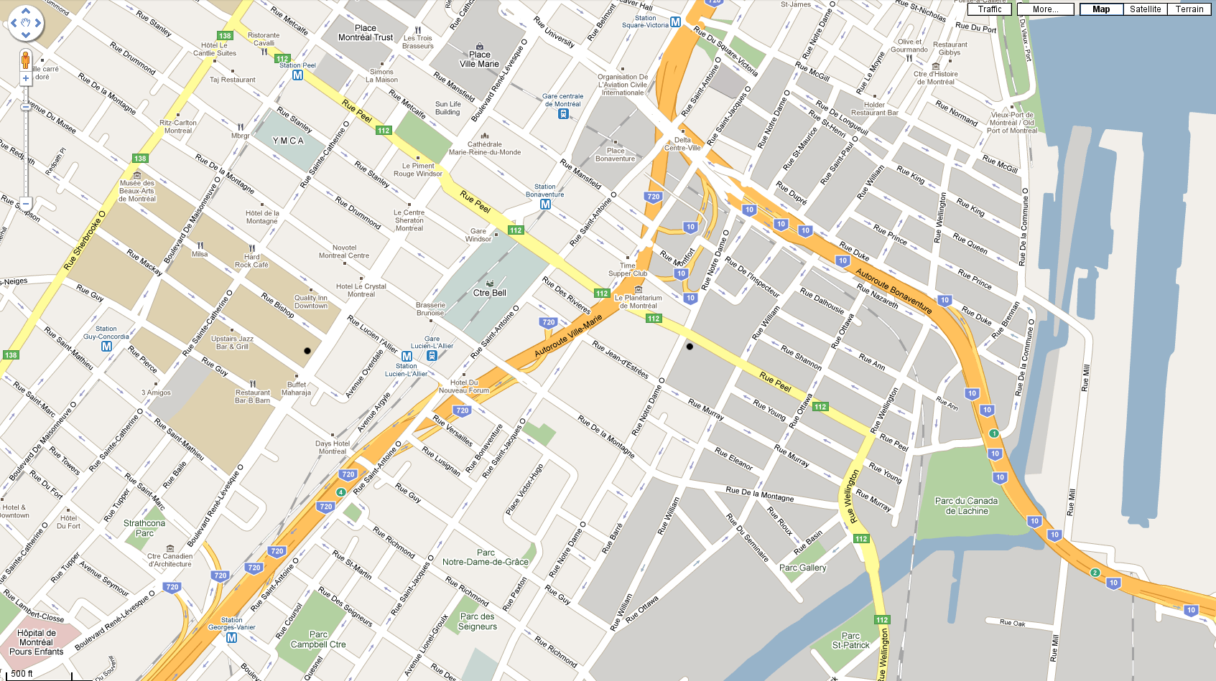

Databases:
Session
Location
Drone
Coordinates
Actions:
Check if in range
TACO
DRONE
OUT OF RANGE

Slide 5

Databases:
Session
Location
Drone
Coordinates
Taco
Taco request
Actions:
Check if in range
Order taco
Change taco type
Get delivery ETA
TACO
DRONE
Type:
ORDER
ETA:
ORDER
5
D
Chicken
mins

Slide 6


Databases:
Session
Location
Drone
Coordinates
Taco
Taco request
Actions:
Change taco type
Cancel change?
TACO
DRONE
Type:
Beef
Chicken
Veggie
CHANGE
CANCEL

Slide 7

Databases:
Session
Location
Drone
Coordinates
Taco request
Actions:
Display drone position
Get ETD
TACO
DRONE
4
D
mins

Slide 8
Databases:
Session
Drone
Fulfilled request
Actions:
Close window
End session and make it a fulfilled request
TACO
DRONE
Delivered
Your taco has been delivered.
Close

Slide 9
Databases:
?
Actions
Display message?
TACO
DRONE
Thank You
This delivery has been made possible by:
YOUR
COM- -PANY
HERE

